Slide 1
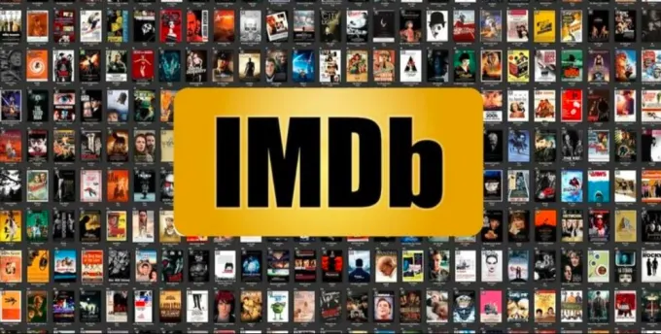
Name: Vikas S Hiremath
ID:AF0378033
Topic:IMDb Top 1000 Movies Analysis

Slide 2
ABSTRACT
This study aims to analyze and present an overview of the IMDb Top 1000 movies.
By examining various attributes such as genre, ratings, and release year, we aim to identify trends and key factors contributing to a movie's popularity.
The dataset offers a comprehensive look at user preferences and movie characteristics.
Through statistical analysis and data visualization, we highlight the top-performing movies and investigate the role of factors such as genre, director, and release year.

Slide 3
Why IMDb Top 1000 Analysis?
Market Insights:
Understand current movie trends, popular genres, and emerging directors.
Film Industry Strategy:
Provide data for filmmakers and studios to strategize releases and marketing campaigns.
Consumer Behaviour:
Reveal insights into viewer preferences and trends.
Economic Impact:
Assess the financial implications of movie ratings and popularity.
Historical Trends:
Understand how movie preferences have evolved over time.

Slide 4
Problem Statement
Analyze the IMDb Top 1000 movies to gain insights into movie popularity, genre trends, and viewer ratings. Create visualizations to showcase top-rated movies, genre distribution, and yearly trends, enabling data-driven decision-making for stakeholders in the film industry.

Slide 5
Aim
Utilize Power Bi for analyzing IMDb's top 1000 movies, providing insights into movie popularity, genre trends, and viewer ratings, thereby facilitating informed decision-making for film industry stakeholders.

Slide 6
Methodology
NumPy:
Provides support for efficient numerical computations and array operations.
Pandas:
Offers data manipulation and analysis tools through dataframes.
Matplotlib:
Enables creating static, interactive, and animated visualizations.
Seaborn:
Builds on Matplotlib to provide a high-level interface for drawing attractive statistical graphics.

Slide 7
Hardware and Software Requirements
HARDWARE REQUIREMENTS:
Processor: Intel Core i5 or equivalent (minimum), Intel Core i7 or higher (recommended)
RAM: 8 GB (minimum), 16 GB or more (recommended)
Storage: 256 GB SSD (minimum), 512 GB SSD or more (recommended)
Graphics: Integrated graphics for basic visualization, dedicated GPU for more intensive visualizations
Display: Full HD monitor (1920x1080 resolution) or higher
Internet Connection: Stable internet connection for downloading datasets and libraries

Slide 8
SOFTWARE REQUIREMENTS:
Operating System: Windows 10 or higher, macOS 10.14 or higher, Linux
Programming Languages: Python 3.6 or higher
IDE/Text Editor: Jupyter Notebook, Visual Studio Code, PyCharm

Slide 9
Summary
This project analyzes the IMDb Top 1000 movies, focusing on movie popularity, genre trends, and viewer ratings. By importing and transforming the data, we created visualizations to display genre distribution, yearly trends, and average ratings. The resulting insights provide stakeholders with actionable information for making data-driven decisions in the film industry.

